Slide 1


Leveraging Prebuilt AI Models in SQL Server 2019
Anna Thomas, Data & Applied Scientist
SQL Server Engineering, Microsoft
Notes:
Hi everyone, my name is Anna Thomas. I’m a data and applied scientist slash PM on the engineering team for SQL Server
How many people were in my other session on SQL ML end-to-end?
So, just a little background on me, about 3 months ago, I moved over from AI Engineering, where I was developing models, but more often than not I was in the space over Conversational AI. So, bots, natural language processing, and really just enhancing applications with AI or ML.
So anyway, I came over from AI Engineering, I’m now in the SQL Server engineering team. So I am very new to SQL. And I don’t want to front like I’m not, because I know all of you in the room are probably experts. Can I actually do a poll? How many of you have been working with SQL for 5 years? 10? 15? 20? More than that??
OK so I will not pretend to be the SQL expert here. What I will promise you though, is if I do not know the answer to your question, I should be able to find it – right, someone in SQL Server engineering should hopefully have the answer, so if you email me, I will get you to the answer.
https://onedublin.files.wordpress.com/2014/06/meme-i-have-no-idea-what-i-am-doing.png

Slide 2
Introduction

Slide 3
Overview
In this session, you'll learn about the various prebuilt AI/ML models that are available for your consumption through Microsoft's Cognitive Services. Additionally, you'll see examples of how these prebuilt services can be leveraged with SQL Server 2019.
Notes:
So let me start by polling the room. How many DBAs do we have? Devs? Data engineer? Data Scientists? Other??
Today I want to show you how you can APPLY AI in your workflows and applications WITHOUT doing data science! Microsoft Research has spent years developing algorithms for you to use, so why reinvent the wheel?

Slide 4
Agenda
WARNING
SQL Server ML Services + Extensibility
AI
Cognitive Services
SQL Server + Cognitive Services
+ Containers
Where to learn more
Notes:
I’m going to show a lot of different tech today. I want you to walk away with new ideas and a new mindset for what you can do in sql server
I also want you to feel empowered
Let’s democratize AI.
SQL Server ML Services + Extensibility – 10 minutes
AI – 5 minutes
Cognitive Services – 5 minutes
SQL Server + Cognitive Services – 15 minutes
+ Containers – 10 minutes
Where to learn more – 10 minutes

Slide 5
SQL Server ML Services + Extensibility
Notes:
Let’s start by looking at SQL Server ML Services and how it’s evolved over the years

Slide 6
The modern development platform
Speed app development and admin with new enhancements
Develop on your choice of language and tooling
Notes:
Bob takes over

Slide 7
Evolution of SQL Server ML Services + Extensibility
Microsoft acquires Revolution Analytics
SQL Server ML Services for R
SQL Server Java Extensibility
2017
2015
2016
2019
R Server → ML Server
SQL Server ML Services for Python
Notes:
Once upon a time, there was a company called Revolution Analytics. Anyone heard of them?
OK so in 2015, Microsoft acquired Revolution Analytics, and fun-fact, half of that company went into my old team in AI Engineering.
Then we came out with a few things. First was R Server, which we we-branded to ML Server because that’s what we do
Then, we said, hey many people have a ton of data sitting in SQL Server already, instead of having to move the data, let’s do analysis in-database. We came out with this capability with R
People loved it so in 2017 we quickly followed with Python
And now, we’re taking a different turn. We made it easy for data scientists to do in database operations and analytics, but what about everyone else? DBAs, Devs, Data Engineers..?
And that’s where this extensibility framework has evolved.

Slide 8

Extend T-SQL with R, Python, and Java
Satellite
R
SQL Server
T-SQL
Direct communications for performance
Launch pad
Notes:
So let me take a step back to explain what’s happening.
SQL Server uses something called the launchpad to launch what we call satellite programs
This runs outside of the SQL Server engine though, which means if my app blows up, the engine is still ok
It doesn’t use TDS but has a separate line of connection to do analytics without moving the data

Slide 9
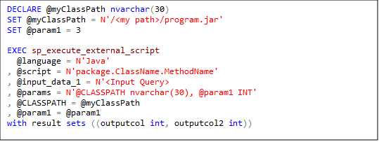
Extend T-SQL with R, Python, and Java
SQL Server
2019
Direct communications
for performance
Satellite
Run Java code using the same SQL Extensibility Infrastructure
Launchpad
Notes:
You can use sp execute external script to run Java code using the same extensibility structure that was used for R/Python. Someone at a previous event in NC asked me, what about other languages? There’s nothing I know about at the moment, but you could see how this door may be opened..

Slide 10
Enhancing the platform of choice
Windows
Linux
Closing features gaps for SQL Server on Linux
Open LDAP Provider support
The Microsoft Container Registry
SQL Server RedHat Container Images
Always On Availability Groups on Kubernetes
Docker containers and Kubernetes
Notes:
On top of this, with SQL 2019, you can also run this wherever you want. You’ll see in a bit that I run SQL in Linux, SSMS in Windows, Azure Data Studio on my mac and windows…. I have lots of options to develop how and where I want.

Slide 11
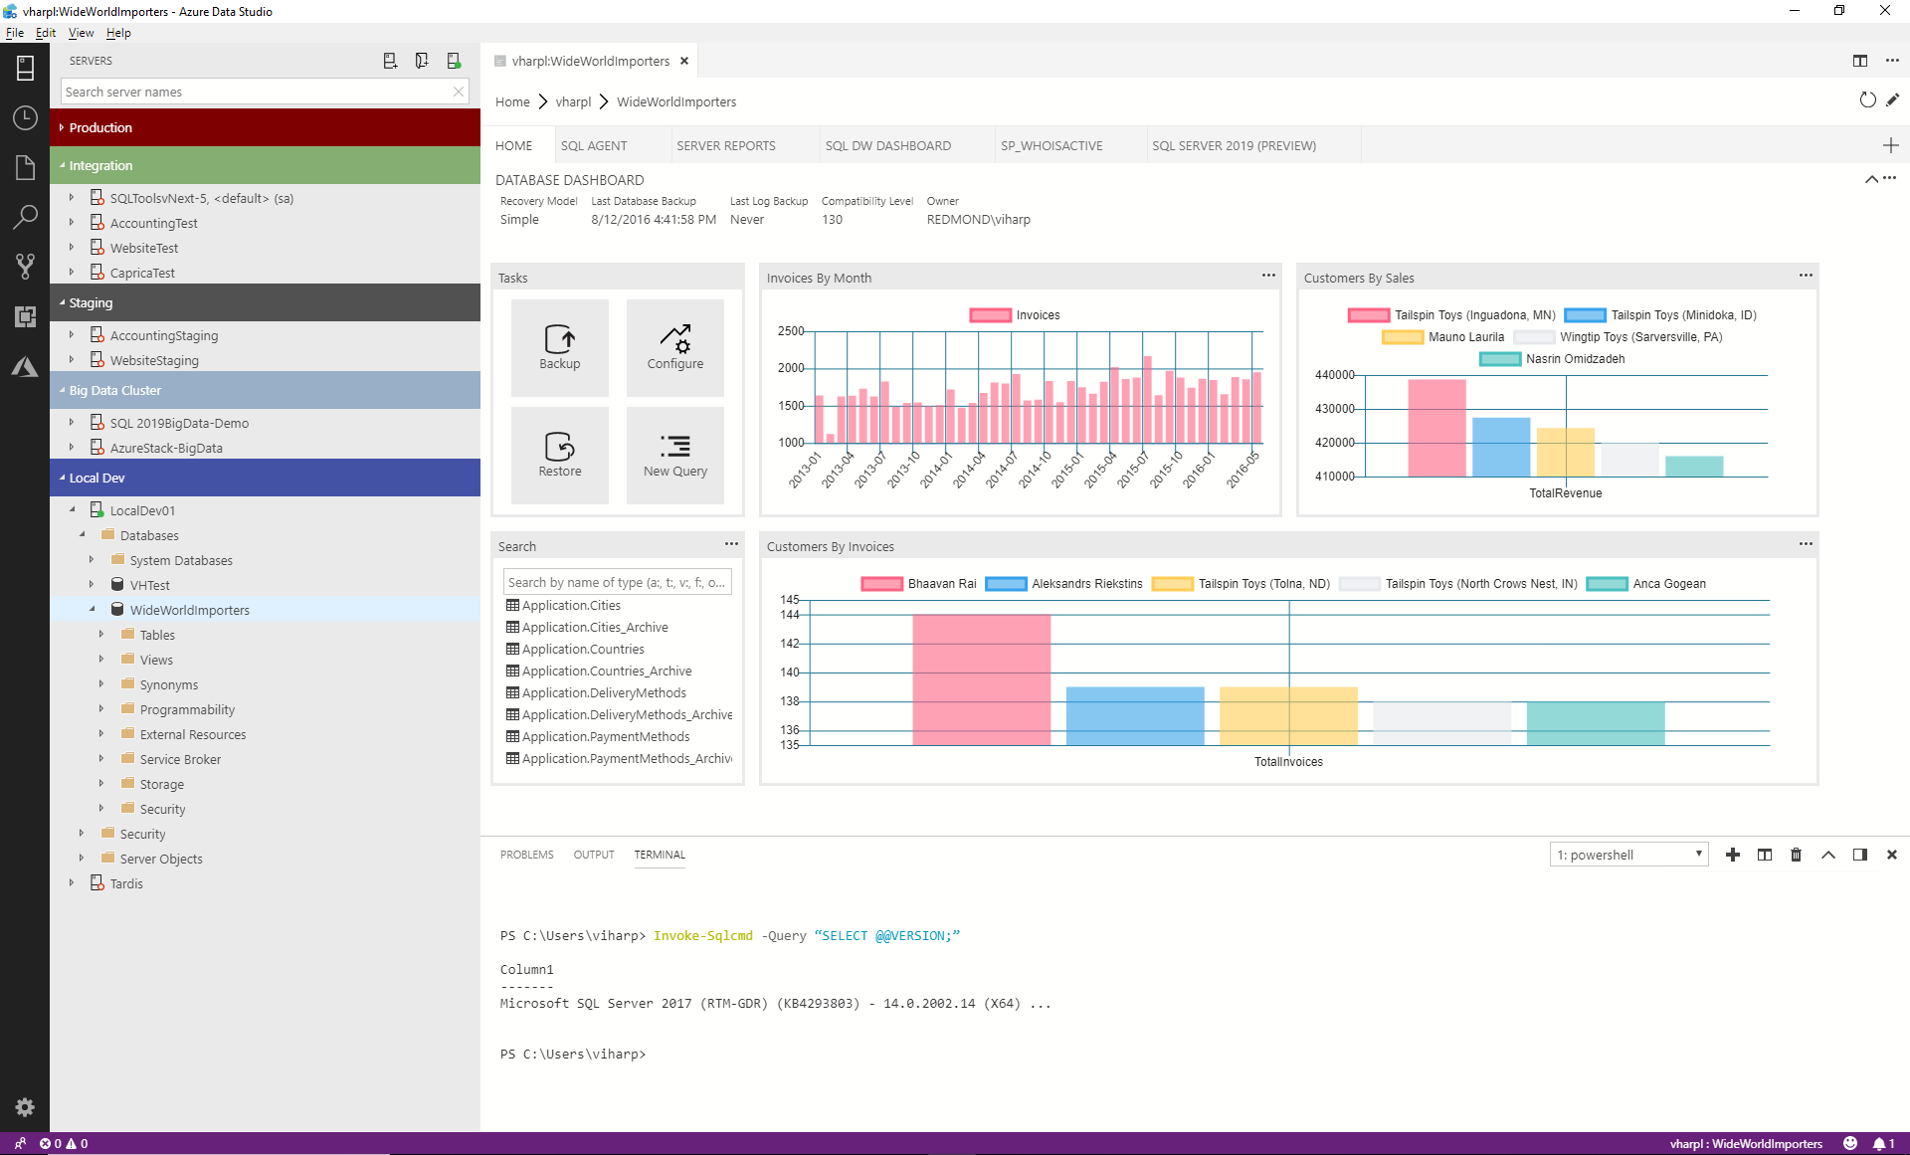
Azure Data Studio
Open source, cross-platform
Graphical management tool
Code editor
Notebook interface
Notes:
So I just want to start by showing you some of the capabilities that the tools team is working on. And, if you saw Vicky’s session, they are moving so fast and doing so much, it’s been so exciting to request a feature on GitHub and see it in the next build!

Slide 12
Azure Data Studio + Java
Demo
Notes:
Poll for how many people were in Vicky or Nellie’s sessions on ADS or Java
Explain the notebooks
Explain the scenario
Poll for experience with Notebooks
Show basic Java demo in notebook

Slide 13
Prebuilt AI

Slide 14

What is AI?
The capability of a machine to imitate human behavior
https://www.analyticsindiamag.com/wp-content/uploads/2017/06/1o40ej.jpg
Notes:
So let’s start by talking about AI. I want to keep this simple and focused.
AI is adding human-like intelligence to your applications

Slide 15
What is Prebuilt AI?
Leveraging existing models to add intelligence to your applications, without having to build the models

Slide 16

Cognitive Services
https://media.tenor.com/images/2322d33b51af745c13e7e397bc9b14c0/tenor.gif

Slide 17






Azure Cognitive Services
Give your apps a human side
Vision
From objects to faces and feelings, enable your apps to analyze still images and video.
Speech
Speak to and hear your users, compensating for environmental noise.
Use with Language for max results.
Language
Analyze text to extract user feeling and intent.
Extract knowledge from existing sources and use it to seed chat bots.
Translate between 60+ languages and growing.
Search
Access billions of web pages, images, videos, and news with the power of Bing.
Knowledge
Preview the newest capabilities from analyzing time series to personalization over reinforcement learning.
Notes:
Microsoft research has been working on some of these algorithms for 20 years
Has anyone heard of these? Anyone used them in applications before?

Slide 18




Cognitive Services capabilities Infuse your apps, websites, and bots with human-like intelligence
Vision
Speech
Language
Knowledge
Search
Object, scene, and activity detection
Face recognition and identification*
Celebrity and landmark recognition
Emotion recognition
Text and handwriting recognition (OCR)*
Customizable image recognition
Video metadata, audio, and keyframe extraction and analysis
Explicit or offensive content moderation
Container support
Speech transcription (speech-to-text)
Custom speech models for unique vocabularies or complex environment
Text-to-speech
Custom Voice
Real-time speech translation
Customizable speech transcription and translation
Speaker identification and verification
Language detection*
Named entity recognition
Key phrase extraction*
Text sentiment analysis*
Multilingual and contextual spell checking
Explicit or offensive text content moderation
PII detection for text moderation
Text translation
Customizable text translation
Contextual language understanding*
Container Support
Q&A extraction from unstructured text
Knowledge base creation from collections of Q&As
Semantic matching for knowledge bases
Customizable content personalization learning
Ad-free web, news, image, and video search results
Trends for video, news
Image identification, classification and knowledge extraction
Identification of similar images and products
Named entity recognition and classification
Knowledge acquisition for named entities
Search query autosuggest
Ad-free custom search engine creation
* Also available with container support
Notes:
So there’s a good number of them now, I think there are around 20… I’ve been working with them for a few years and it’s been really cool to see them turn into products and be put into production application
Vision: Image-processing algorithms to smartly identify, caption and moderate your pictures
Computer vision: Distill actionable information from images
Content Moderator: Automatically moderate potentially offensive images, text and videos
Customer Vision Service: Train a web service to recognize specific content in images
Face: Identify human faces and emotions in images
Video indexer: Easily extract insights from your videos to enrich your applications
Speech: Convert spoken audio into text, use voice for verification, or add speaker recognition to your app
Bing Speech: Convert speech to text and text to speech
Speaker Recognition: Use speech to identify and authenticate individual speakers
Custom Speech Service: Overcome speech recognition barriers like speaking style, background noise, and vocabulary
Translator Speech: Easily conduct real-time speech translation on your app
Language: Enable your apps to process natural language with pre-built scripts, evaluate sentiment and learn how to recognize what users want
Bing Spell Check: Add spell checking functionality to your app
Language Understanding (LUIS): Add language understanding intelligence to your apps with minimal effort
Linguistic Analysis: Easily parse complex text with language analysis
Text Analytics: Easily evaluate sentiment, language, and key phrases to understand what users want
Translator Text: Easily conduct machine translation for 60+ languages
Knowledge: Map complex information and data in order to solve tasks such as intelligent recommendations and semantic search
Knowledge Exploration Service: Enable interactive search experiences over structured data via natural language inputs
Entity Linking Service: Power your app's data links with named entity recognition and disambiguation
Academic Knowledge: Tap into the wealth of academic content in the Microsoft Academic Graph using the Academic Knowledge API
QnA Maker: Distill information into an easy-to-navigate FAQ for bot services
Customer Decision Service: Create custom experiences with adaptive, contextual decision-making
Search: Add Bing Search APIs to your apps and harness the ability to comb billions of webpages, images, videos, and news with a single API call
Bing Autosuggest: Give your app intelligent autosuggest options for searches
Bing News Search: Search for news and get comprehensive results
Bing Web Search: Get enhanced search details from billions of web documents
Bing Entity Search: Enrich your experiences by identifying and augmenting entity information from the web
Bing Image Search: Search for images and get comprehensive results
Bing Video Search: Search for videos and get comprehensive results
Bing Custom Search: Create tailored site search or vertical search experiences for topics you care about
Labs: Cognitive Services Labs are early preview limited availability leading innovation APIs and SDKs that allow developers to start experimenting with Microsoft’s latest and greatest Cognitive Services.
Project Prague: SDK to incorporate gesture-based controls into your apps. Quickly define and implement customized hand gestures, creating a more natural user experience. Limited private preview availability at launch.
Project Cuzco: API to help developers find events associated with Wikipedia entities. Begin with a Wikipedia entity, and receive a list of related events organized by time.
Project Johannesburg: API to calculate route logistics for with deeper location intelligence to account for specific enterprise requirements. IE: weight, height length, hazardous materials, etc.
Project Nanjing: API to calculate isochrones - time and distance-based recommendations for enterprise route optimization.
Project Abu Dhabi: API to create distance matrices, enabling you to calculate a histogram of travel times, and serve as stepping stone for enterprise route optimization.
Project Wollongong: API to help ‘score’ the attractiveness of a location, based on how many of a particular amenity are within a specific distance. Ex: restaurants, parks, transit stops.
With Cognitive Services, developers can easily add intelligent features – such as emotion and sentiment detection, vision and speech recognition, knowledge, search and language understanding – into their applications. The collection will continuously improve, adding new APIs and updating existing ones.
Cognitive Services includes:
<click>
Vision: From faces to feelings, allow apps to understand images and video
<click>
Speech: Hear and speak to users by filtering noise, identifying speakers, and understanding intent
<click>
Language: Process text and learn how to recognize what users want
<click>
Knowledge: Tap into rich knowledge amassed from the web, academia, or your own data
<click>
Search: Access billions of web pages, images, videos, and news with the power of Bing APIs
Why choose these APIs? They work, and it’s easy.
<click>
Easy: The APIs are easy to implement because of the simple REST calls. There’s a common way to implement, and you can get started with all of them for free simply by going to one place, one website, www.microsoft.com/cognitive.
Flexible: We’ve got a breadth of intelligence and knowledge APIs so developers will be able to find what intelligence feature they need. And, importantly, they all work on whatever language, framework, or platform developers choose. So, developers can integrate into their apps—iOS, Android, Windows—using their own tools they know and love.
Tested: Tap into an ever-growing collection of powerful AI algorithms developed by experts. Developers can trust the quality and expertise build into each API by experts in their field from Microsoft’s Research organization, Bing, and Azure machine learning and these capabilities are used across many Microsoft first party products such as Cortana, Bing and Skype.
Transition: When it comes to real-world applications for Cognitive Services, the sky is the limit! Let’s look at some examples.
<click>

Slide 19
Intelligent Kiosk
Demo
Notes:
OK to be honest this demo isn’t related to the Wide World Importers scenario specifically, but I think it’s kind of cool to see one of them in action. Has anyone seen this before?
Show off the face api in the intelligent kiosk app, just to show a cool thing around cognitive services, doesn’t need to be long

Slide 20

SQL Server + Cognitive Services
https://www.bing.com/images/search?view=detailV2&ccid=Rj03o6HB&id=6F0628643401715660CA923AFBF66CBB87E710B3&thid=OIP.Rj03o6HBVF3L7ioCd7VhTQHaD0&mediaurl=https%3a%2f%2fmedia.giphy.com%2fmedia%2fwe3xXKFa8Afi8%2fgiphy.gif&exph=258&expw=500&q=get+to+the+point+meme+gatsby&simid=607996891923942532&selectedIndex=38&ajaxhist=0
Notes:
So we’ve talked about SQL Server. We talked about extensibility and Java. We talked about Cognitive Services. But how does it fit together?

Slide 21
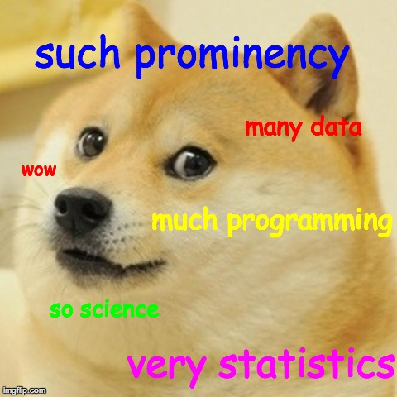
SQL Server + Cognitive Services
Add intelligence to your data WITHOUT Data Scientists
https://i.imgflip.com/6996y.jpg
Notes:
SQL Server 2019 builds on the strength of previous releases. SQL Server has evolved from a departmental database in 2008R2 and before to a mission-critical, industry-leading database. In recent releases, we’ve added in-memory performance, innovative security features, end-to-end mobile intelligence, built-in AI, and support of OS, including Linux. With SQL Server 2019, we’ve invested heavily in big data…

Slide 22

Face Recognition
Face detection
Detect faces and their attributes within an image
Face verification
Check if two faces belong to the same person
Similar face searching
Find similar faces within a set of images
Face grouping
Organize many faces into groups
Face identification
Search which person a face belongs to
Notes:
Does anyone store images in file tables? My understanding is you don’t really do that but I could be wrong so I left this slide..

Slide 23


Computer Vision
Analyze an image
Understand content within an image
OCR
Detect and recognize words within an image
Recognize celebrities
Thanks to domain-specific models, ability to recognize 200K celebrities from business, politics, sports, and entertainment around the world
Notes:
Same thing here. Now the OCR thing is super cool because they’re actually working on advancing this to actually read and analyze forms, but I’m not exactly sure where we’re at with that.

Slide 24


Text Analytics
Sentiment analysis
Understand if a record has positive or negative sentiment
Key phrase extraction
Extract key phrases from a piece of text, and retrieve topics
Language detection
Identify the language, 120 supported languages
Notes:
This is one I think could be used today in SQL, on any of your free form columns. This could be review data, comments from sales, delivery notes, failures in manufacturing…I think there are lots of ways you could incorporate these three aspects of the Text Analytics API into your SQL workflows and applications

Slide 25


Language Understanding Intelligent Service (LUIS)
Understand what your users are saying and create agents that perform custom actions
Use pre-built models or create your own
Notes:
Finally there’s LUIS, which is used primarily for Conversational AI types of application. However, if those transcripts are being recorded in SQL, you have options to extract the actions users are trying to perform
Understand language contextually, so your app communicates with people in the way they speak.
Do your apps understand language in the way people speak it—contextually? With the Language Understanding Intelligent Service (LUIS) API, you can integrate language models that understand your users quickly and easily. And if one of our preexisting models won't work, it will guide you through building your own.
Prebuilt models will recognize places, times, numbers, and temperatures, and handle common requests like "set an alarm for 8 AM." LUIS supports dialogue and action fulfillment, so your users can carry on a conversation with your app. For example, the input "schedule a meeting with Allison" results in the question "when?," allowing the user to respond "3 PM," and the meeting gets scheduled.

Slide 26
SQL Server + Cognitive Services
Demo
Notes:
Show how we created the java program and got it running. Spend a good chunk of time here
First show the Java program in Elipse, talking about how easy it was to create.
Took the sample from Cognitive Services docs, which has lots of basic samples for different languages, including Java
And I took the sample from the Java extensibility docs, and basically combined them.
Show how I load it up into Linux
Show how

Slide 27

Does anyone see any issues with this?
Notes:
Get back to sending data to the api
Latency

Slide 28
Why might you want a container?
Enterprise need
Unable to load data into the cloud
Regulatory requirements
Security/Privacy concerns
Low bandwidth or intermittently connected
Customer benefits
Control over data
Control over model updates
High throughput/low latency
Notes:
There are many reasons why you might not want to send every request out to the internet. Maybe you’re unable to load data into the cloud. Maybe you have intermittent connections.

Slide 29
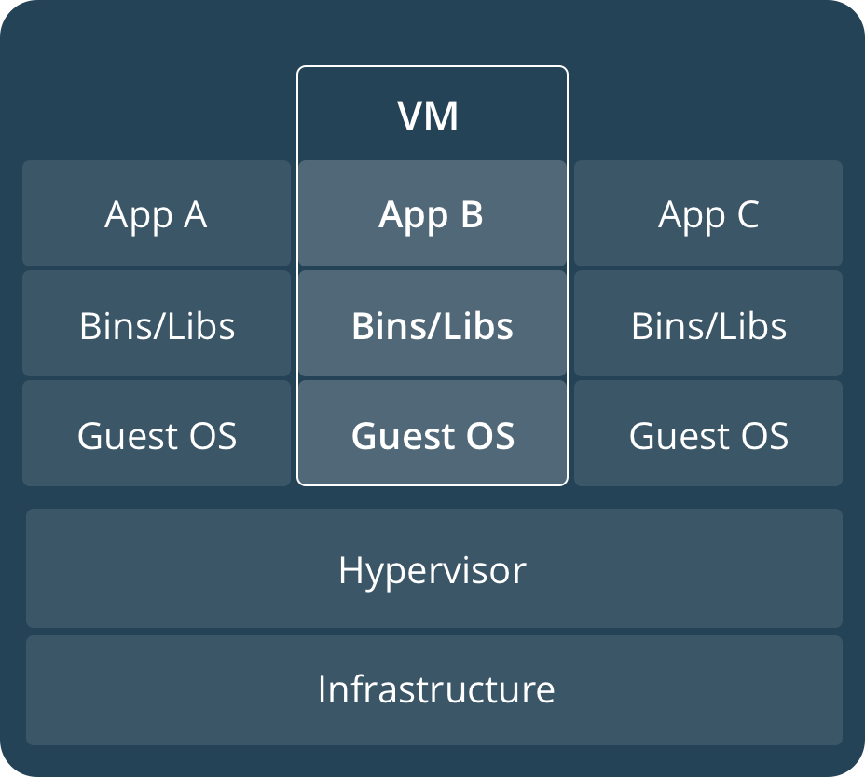
Virtualization Hardware Abstraction
Building on hardware, you can create a complete “PC” on top of a Hypervisor layer, which abstracts out the hardware. You still own the Operating System and up
This allows for scale by ring-fencing OS-level dependencies
Notes:
I know most of you are probably familiar with containers, but does anyone want me to briefly explain containers vs VMs?
One abstraction layer above installing software directly on hardware is using a Hypervisor. In essence, this layer uses the base operating system to emulate hardware. You install an operating system (called a Guest OS) on the Hypervisor (called the Host), and the Guest OS acts as if it is on bare-metal.
In this abstraction level, you have full control (and responsibility) for the entire operating system, but not the hardware. This isolates all process space and provides an entire "Virtual Machine" to applications. For scale-out systems, a Virtual Machine allows for a distribution and control of complete computer environments using only software.

Slide 30
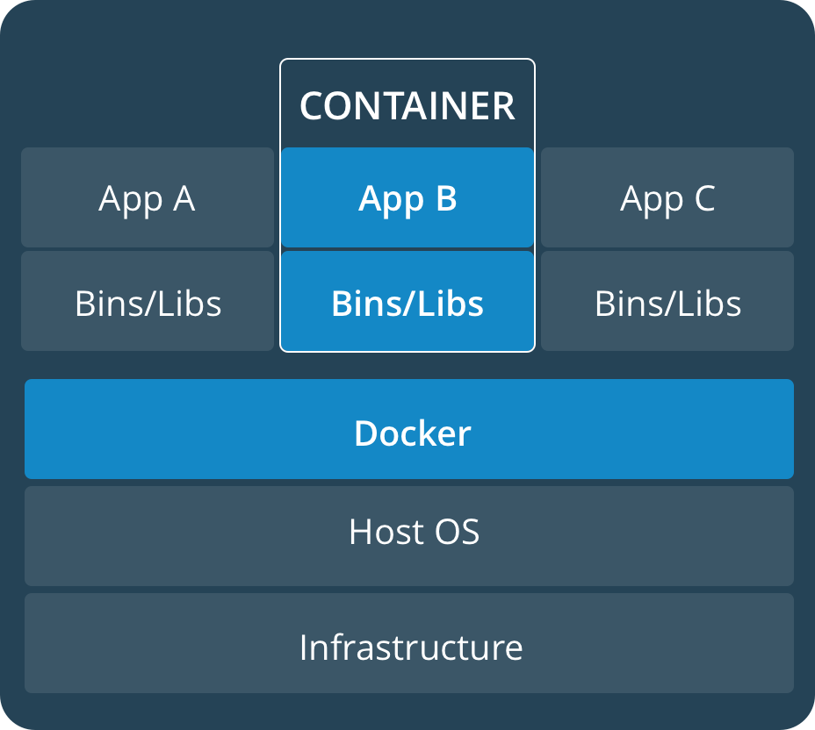
Containers Abstracting the OS, Allowing complete portability
Containers go one level further than the Hypervisor, and focusing on binaries and applications
Storage and networking are a consideration
Scale is achieved through multiple containers
Notes:
The next level of Abstraction is a Container. There are various types of Container technologies, but let’s talk about Docker.
A Docker Container is provided by the Docker runtime engine, which sits above the operating system (Windows or Linux). In this abstraction, you do not control the hardware or the operating system. The Container has a very small Kernel in it, and can contain binaries such as Python, R, SQL Server, Cognitive Services, or other binaries. A Container with all its binaries is called an Image.
This abstraction holds everything for an application to isolate it from other running processes. It is also completely portable - you can create an image on one system, and another system can run it so long as the Docker Runtime is installed. Containers also start very quickly, are easy to create

Slide 31



Azure Cognitive Services in Containers
SQL Server
At the edge and disconnected
Meet every regulatory requirement
Cloud application model on-premises
Notes:
When you deploy a cognitive service in a container, you get access to the model locally. So the main point here is we can operate on prem

Slide 32

Now In Public Preview
Cognitive Services Containers
No app changes & Compatible with full Cognitive Services feature-set
Support for 6 key AI capabilities:
Key Phrase Extraction
Language Detection
Sentiment Analysis
Face & Emotion Detection
OCR / Text Recognition
Language Understanding
Run & manage locally, Try for free
Connect to Billing service for report back, unified billing with on-cloud and off-cloud transactions
Additional Capabilities coming soon (e.g. Speech)
Notes:
Here’s what’s available today.
It does connect to the internet, once every 15 minutes, and the team is working on how billing would work for scenarios with very little or no connectivity

Slide 33
SQL Server + Cognitive Services + Containers
Demo
Notes:
Deploy and run the container
Do a live switch of the app from REST to local
docker pull mcr.microsoft.com/azure-cognitive-services/keyphrase:latest
Can change first port number to run multiple
docker run --rm -it -p 6000:5000 --memory 4g --cpus 1 mcr.microsoft.com/azure-cognitive-services/sentiment Eula=accept Billing=https://southcentralus.api.cognitive.microsoft.com/text/analytics/v2.0 ApiKey=APIKeyHere

Slide 34
Where to learn more

Slide 35
Resources
Slides from today: https://aka.ms/annalytics
SQL Workshops: https://aka.ms/sqlworkshops
Related sessions later today – BDC, ADS

Slide 36
Questions? Product Feedback? Ideas for AI and SQL Server? Thank you!
Twitter: @AnalyticAnna
LinkedIn: amthomas46
antho@microsoft.com
Notes:
Now, I know, and you all know, that I’m pretty new to this whole thing. So, if I can’t answer your question, I will get you the answer. Just send me an email and I will find it

